Slide 1


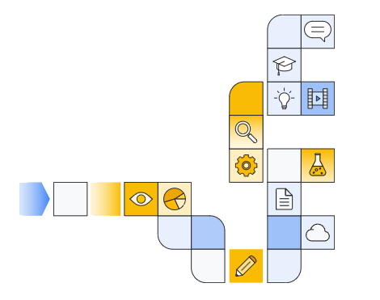

Notes:
https://www.cloudskillsboost.google/paths/183/course_templates/552

Slide 2
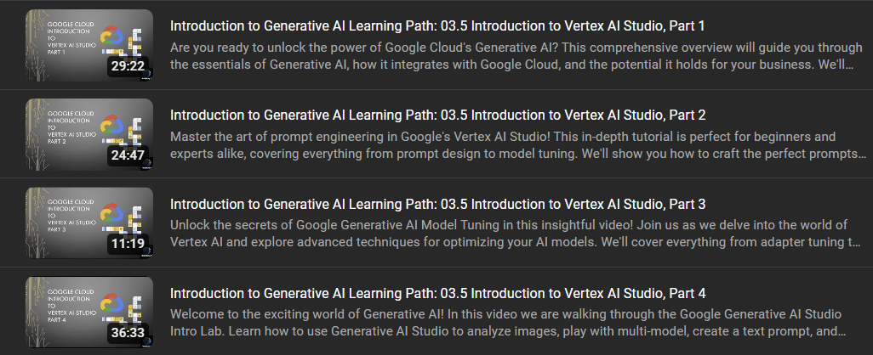
Notes:
https://www.youtube.com/watch?v=2TF1cWe3RVs&list=PL7hc7ZLdMi6pnHGCEU3v68bmS-tBpBHjk

Slide 3


